Slide 1
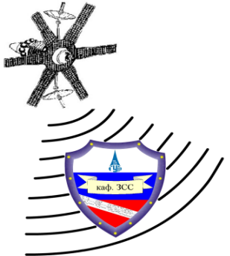
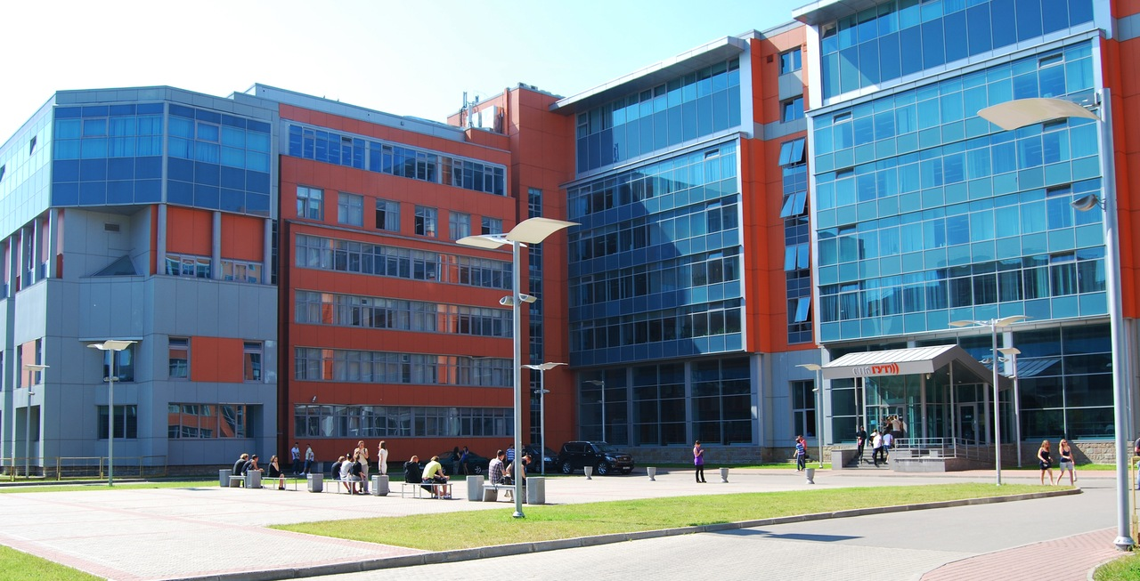
The Bonch-Bruevich Saint-Petersburg State University of Telecommunications
Brief information about organization of security programs in SPbSUT
Head of the department of secured communications systems
Ph.D., prof. Krasov Andrey Vladimirovich
Email: krasov@inbox.ru
Mob.: +7 921 999 03 14
www.sut.ru www.zss.sut.ru

Slide 2
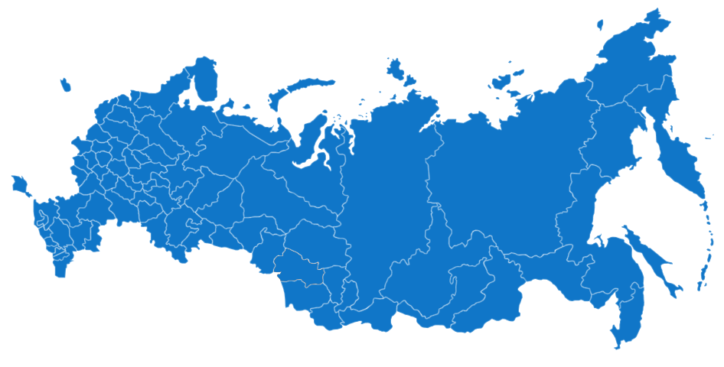
Special training for the telecommunications industry in Russia is providing by 4 high schools:
SIbSUTIS
PSUTI
MTUCI
SPbSUT
On the North-West of Russia is the SPbGUT
ü

Slide 3
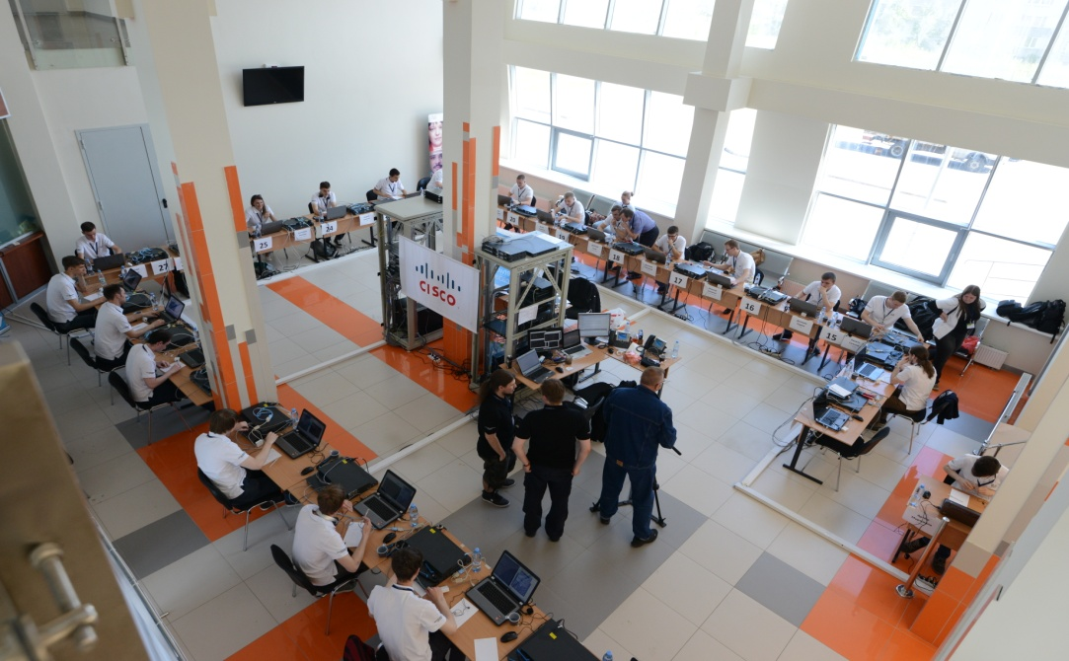
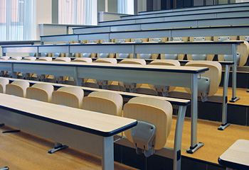
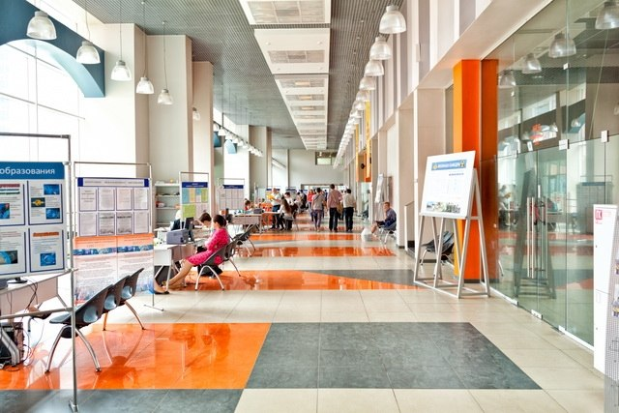
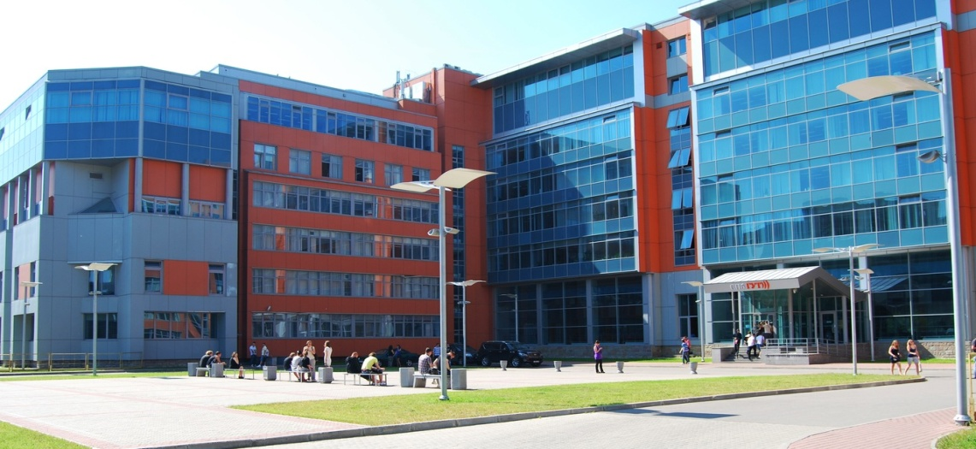
Notes:
2+ слайд фотки

Slide 4
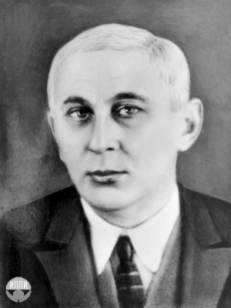
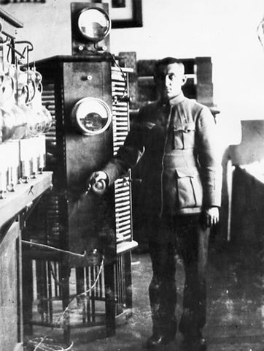
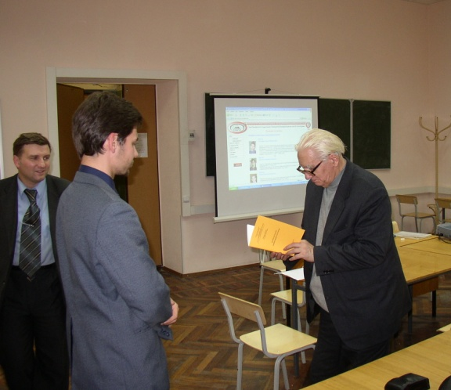
Professor Mikhail Aleksandrovich Bonch-Bruevich
SPbSUT named after professor Mickhail Aleksandrovich
Bonch-Bruevich (1888-1940), great scientist, inventor of soviet
radio industry and first radio stations. Teacher and one of the
leaders of our university in 1931-40 years.
In 1918, Bonch-Bruevich went to Nizhny Novgorod and began an affiliation
with a prestigious private Nizhny Novgorod Radio Laboratory.
There he continued with research in vacuum tubes, and developed a 40-kilowatt,
water-cooled tube that he used to build Komintern Radio in Moscow,
one of the most powerful radio station in the world. He became the national proponent of radio broadcasting, building 27 stations in various cities.
Specialty Secured Communication Systems familiar with the son of M.A.Bonch-Bruevich – professor Andrey Mikhailovich Bonch-Bruevich (1932—2011)

Slide 5
The Bonch-Bruevich Saint-Petersburg State University of Telecommunications
ü
SPbSUT was founded in 1930 year
ü
SPbSUT consists of:
8 faculties;
38 departments;
Institution of military education;
College of telecommunications.
2 branches (Smolensk and Arkhangelsk cities);
ü
There are 30 higher education programs in SPbSUT. Total number of local students about 5000, foreign students about 2000

Slide 6
The Bonch-Bruevich Saint-Petersburg State University of Telecommunications
ü
19 bachelor degree programs
ü
10 master degree programs
ü
1 specialty

Slide 7
Bachelor’s degree programs
09.03.01 Informatics and computer engineering
09.03.04 Software Engineering
10.03.01 Information security
11.03.02 Info communication Technology and Communication systems
Including program of Secured Communications Systems
12.03.03 Photonics и Optic-informatics
43.03.01 Service
11.03.01 Radiotechnics
11.03.03 Design Engineering and Electronic Instrumentation Technology
12.03.04 Biotechnical Systems and Technology
27.03.01 Standardization and Metrology
09.03.02 Information Systems and Technology
15.03.04 Technology Processes and Productions Automation
27.03.04 Management in Engineering Systems
38.03.02 Management
38.03.05 Business Informatics
11.03.04 Electronics and Nanoelectronics
05.03.06 Ecology and Management of Natural Resources
41.03.01 Foreign Affairs
42.03.01 Advertising and Public Relations

Slide 8
Master degree programs
10.04.01 Information security
11.04.02 Infocommunication Technology and Communication systems
Including program of Secured Communications Systems
11.04.01 Radiotechnics
11.04.03 Engineering design and Electronic Instrumentation Technology
27.04.01 Standardization and Metrology
09.04.02 Information Systems and Technology
15.04.04 Technology Processes and Productions Automation
38.04.05 Business Informatics
41.04.01 Foreign Affairs
42.04.01 Advertising and Public Relations

Slide 9
Training experts in information security area
ü
Specialty Secured Communication Systems Department
The department of Secured Communication Systems was founded in November 1997 with the goal of training specialists in the field of information security and systems of telecommunications based on group of professors teaching a course about info-security and laboratory of scientific-research center information and telecommunication technologies.
Head of the department Ph.D., prof. A.V. Krasov.

Slide 10
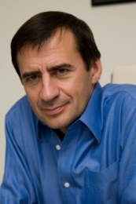
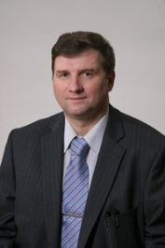
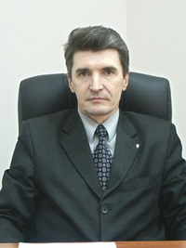
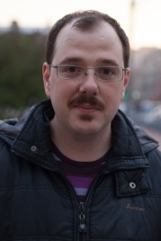
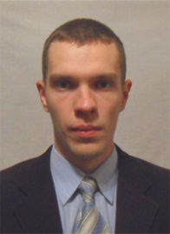
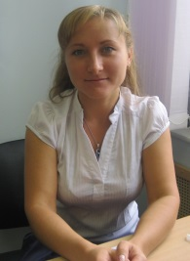
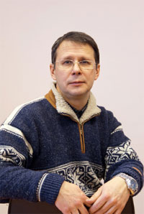
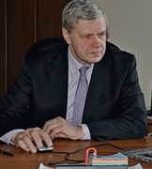
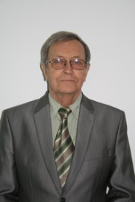
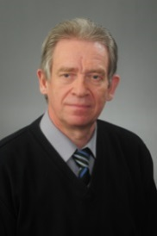
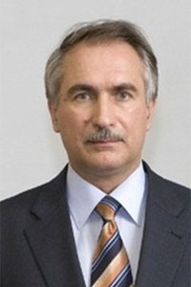
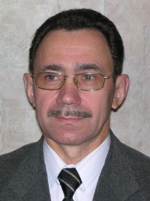
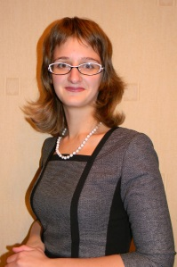
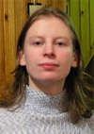
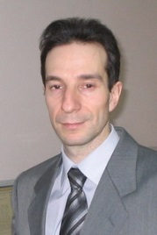
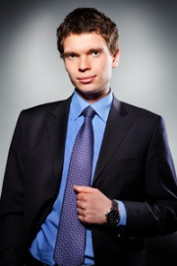
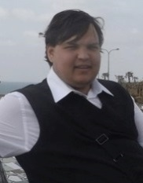
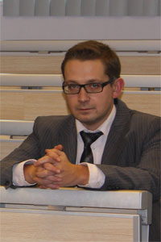
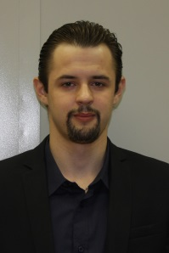
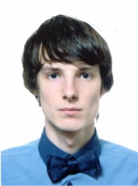
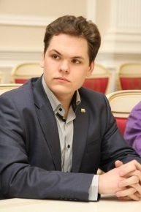
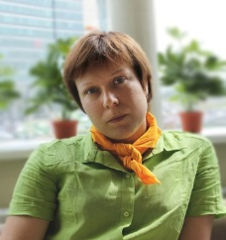
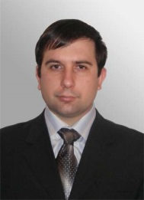
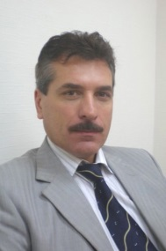
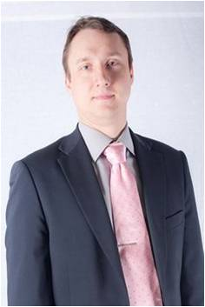
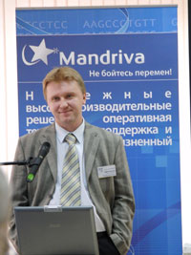
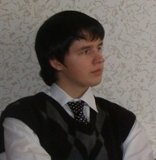
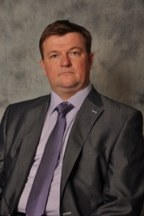
Teachers of the department
Full Professors
Ph.D. Professors
Associate professors
Assistants

Slide 11
Профессорско-преподавательский состав кафедры
Prof. Valery Ivanovich Korzhik is one of the famous scientists in Russia in the area of Cryptography and Steganography. He also works in our department.

Slide 12
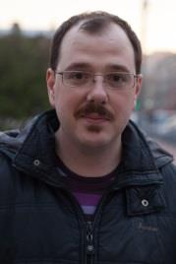
Профессорско-преподавательский состав кафедры
Heads of government companies, employees of state services of Russia works in our department.

Slide 13
Профессорско-преподавательский состав кафедры
Also heads and lead employees of huge info-communication companies of the region works in our department.

Slide 14
Профессорско-преподавательский состав кафедры
We’re – one of the most youngest team of the university!

Slide 15
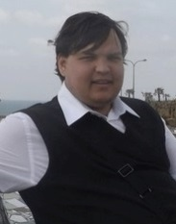
Профессорско-преподавательский состав кафедры
8 teachers are graduates of our department, continuing co-working and scientific research.

Slide 16
Профессорско-преподавательский состав кафедры
4 teachers came in the department when they were pupils.
Notes:
Вставить слайд по инфофоруму, лучшая кафедра ИБ в России обязательно большой вид аудитрии (с Infoforu.ru) и наши награды
Вставить на 1-ю страницу награду

Slide 18
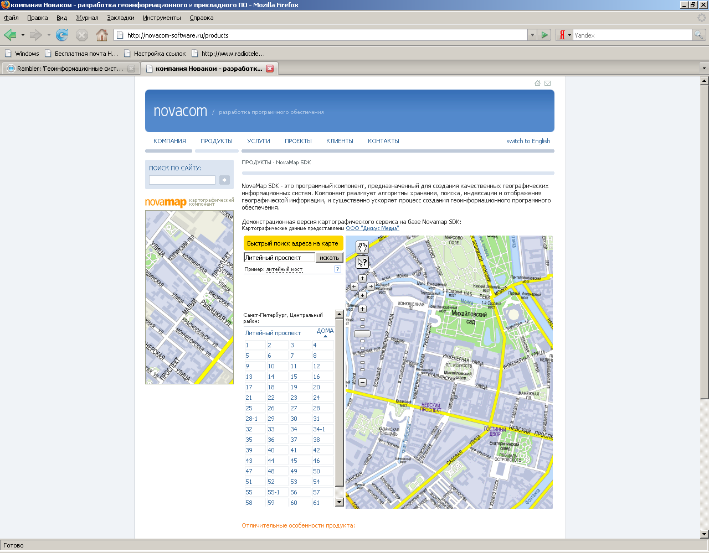
Scientific researches in the department
During 18 years there were made more than 10 scientific works on government and commercial needs in the department
ü
ü
The most largest work was development of specialized geo-information systems for the government of Russian Federation (lead prof. A.V. Krasov). Work was done by students and PhDs of the department
Notes:
Добавить обложки книг

Slide 19
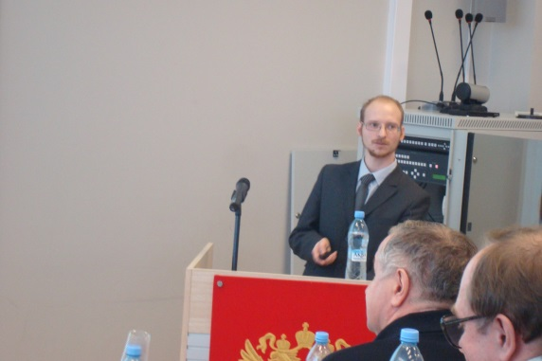
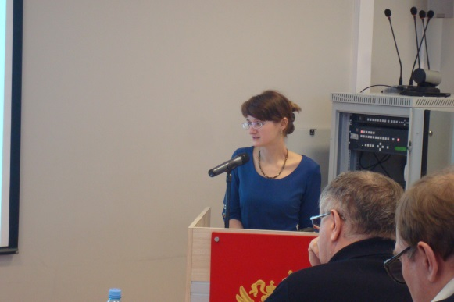
Scientific researches in the department
ü
During 18 years employees of the department defended : 1 doctor of science work, 9 PhD works (in area of Russia), 1 PhD (international). PhD students of the department defended 7 works.
ü
There were 5 monographs and study books, also translated, published in the department.

Slide 20
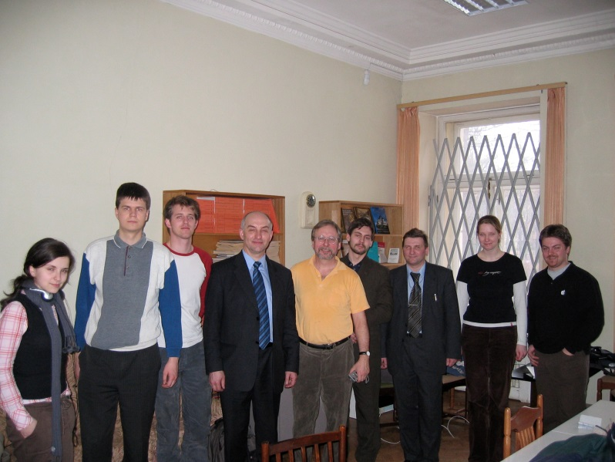
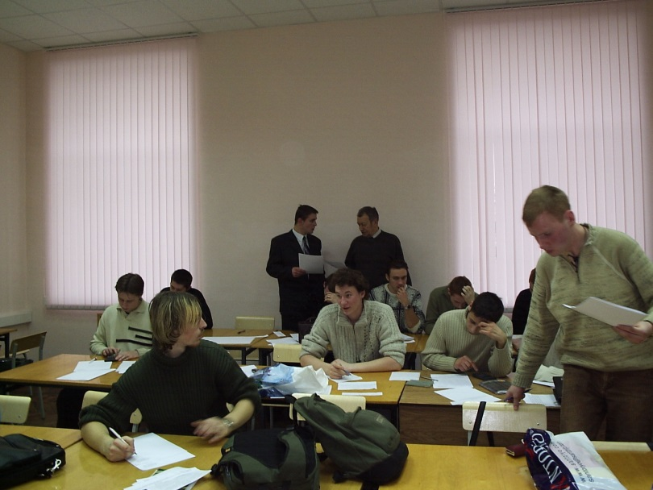
Student scientific-research projects
Our department actively involve students, masters and PhDs for projects, scientific-research works, development of education software.
ü
Based on our department there was organized the summer school– student scientific village. Leader – prof. A.V. Krasov
ü
In 2016 year based on our department we will organize summer school for masters of the joint program 10.04.01 «Information Security»
ü

Slide 21
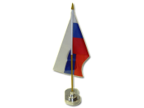
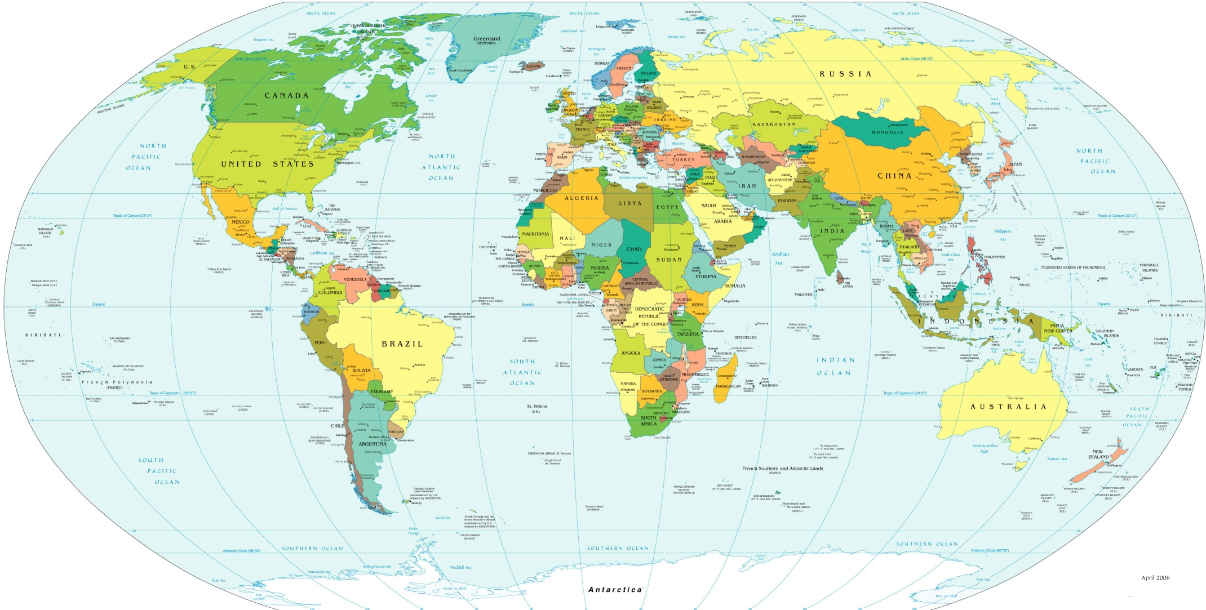
International cooperation
ü
From foundation of our department our teachers actively worked as guest lecturers or trainings in lead universities and educational centers of the world. At first we should mention prof. V.I. Korzhik, prof. M.V. Buinevich, D.I. Kirillov, I.A. Ushakov.

Slide 22
International cooperation
ü
Our teachers participates in different international scientific and methodical projects in different countries of the world.
Based on our department there were organized meetings on Tempus project, specialized trainings of teachers.
Notes:
Убрать слайд

Slide 23
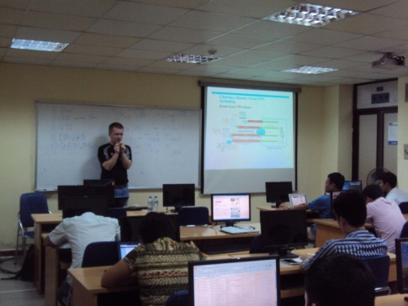
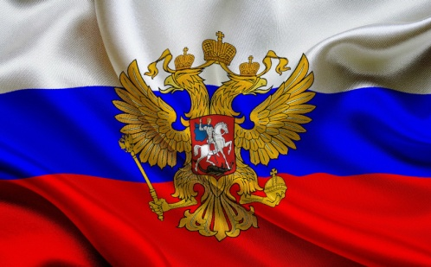
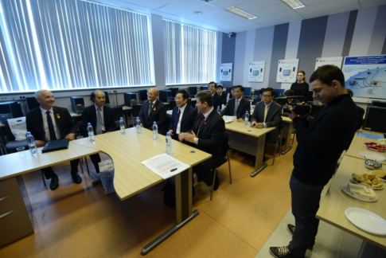
Joint bachelor program «Information security»
ü
In 2014 year was signed an agreement between SPbSUT and PTIT
Studying in Vietnam
1
2
Studying in SPbSUT,
bachelor degree defense
3
4
First two years students study in PTIT (Vietnam), next 2 years in SPbSUT
ü

Slide 24
Joint bachelor program «Information security»
During the program there were:
ü
Meeting in SPbSUT with Minister of IT Vietnam
ü
Associate prof. D.I. Kirillov made a training for two weeks with specialists of PTIT
ü
Two months training of teachers PTIT based on our department (December 2014 – February 2015)

Slide 25
Partners
Participates in Tempus project
ü
In 2013 year SPbSUT joint to Tempus project «Educating the Next generation experts in Cyber Security: the new EU-recognized Master’s program (ENGENSEC)».
ü
Main goal of the project – to create new Master’s program in area of IT Security as a response on current and emerging cybersecurity threats by educating the next generation experts in this area, thus supporting development of e-based
economics, life and society in partner countries. SPbSUT participation in this project gives an opportunity to move student education on international level.
ü
In October 2013 EU elected from Russia eight universities for realization of master program on English language in area of information security. SPbSUT was among them.
ü
Number of the project -544455-TEMPUS-1-2013-1-SE-TEMPUS-JPCR
ü
Full name of the project: Educating the Next generation experts in Cyber Security: the new EU-recognized Master’s program
ü
Duration - 36 months; Budget– 975 041,78 €.
ü
Decision of EU– official recognition of highest quality of education in area of information security.

Slide 26
Partners
Participates in Tempus project
There are 22 organizations from 7 countries participates in the program: from Sweden, Poland, Latvia, Russia, Ukraine, Greece and Germany.
ü
During international competition there were elected only four educational programs from Russia, among them master program “Information Security”, realizing in our department

Slide 27
Joint master program ENGENSEC Tempus
During the work on the project:
ü
We analyzed national educational standards and laws of education of countries-participants
ü
There was created an education plan unified for all the universities with 7 subjects included
There were developed and agreed subjects, included in master education plan
ü
ü
Program successfully passed international monitoring with national Tempus and Erasmus offices in partner-countries

Slide 28
Joint master program ENGENSEC Tempus
Semester/Credits | 1 | 2 | 3 | 4 | 5 | 6 | 7 | 8 | 9 | 10 | 11 | 12 | 13 | 14 | 15 | 16 | 17 | 18 | 19 | 20 | 21 | 22 | 23 | 24 | 25 | 26 | 27 | 38 | 29 | 30
1 | National federal component |  |  |  |  |  |  |  |  |  |  |  |  |  |  |  |  |  |  |  | Practice (Rus)
 |  |  |  |  |  |  |  |  |  |  |  |  |  |  |  |  |  |  |  |  | Subject to Ukraine
2 | Tempus subject (common) 7 з.е. |  |  |  |  |  |  | Tempus subject (common) 7 з.е. |  |  |  |  |  |  | Tempus subject (common) 7 з.е. |  |  |  |  |  |  | Practice (Rus)
 |  |  |  |  |  |  |  |  |  |  |  |  |  |  |  |  |  |  |  |  |  | Subgect to Ukraine
3 | Tempus subject (common) 7 з.е. |  |  |  |  |  |  | Tempus subject (common) 7 з.е. |  |  |  |  |  |  | Tempus subject 8 з.е. |  |  |  |  |  |  |  | Practical
4 | Practice |  |  |  |  |  |  |  |  |  |  |  |  |  |  |  |  |  |  |  |  | Final certification
ü
ü
Advanced Network & Cloud Security
Malware
ü
ü
Wireless & Mobile Security
WebSecure
ü
ü
Secure Software Development
Pentest & Ethical hacking
ü
ü
Digital Forensic
ReSeLa
Notes:
Слайд взять из презентации магистров ИБ,
После этого добавить слайды с описанием предметов из той же самой презентации они выше 35, 37 и дисциплины 1-го семетра. Порядок слайдов 34, 38, 40, далее дисциплины и заканчиваем руководителями

Slide 29
Кафедра Защищенных систем связи признана Лучшим образовательным центром России в области информационной безопасности по результатам проведенного весроссийского конкурса Инфофорум 2016

Slide 30
международная Летняя школа студентов ENGENSEC 2016 г.

Slide 31
Cisco Networking Academy Program
In 1999 year there was opened the first on North-West Region Cisco Networking Academy based on our department.
ü
Programs of Cisco Networking Academy were integrated in these education bachelor programs:
10.03.01 «Information Security»,
43.03.01 «Service», profile Service of security systems
11.03.01 «Info-communication technologies and systems of telecommunications» profile Secured systems and networks
ü
Students also have an opportunity to study Cisco Networking Academy program as additional program
ü
After graduating the program students have ability to pass certification tests for CCNA, CCNA Security and CCNP with discounts.
ü

Slide 32
Russian Cisco Olympic game «Networking Technologies»
On 17-18 of July based on our Cisco Networking Academy there was organized the final Russian Cisco Olympic game between students from different universities of Russia.
ü
There were 30 people participated in the game from different regions of Russia. In particular, from universities of telecommunication area there were: two student from SibGUTI, MTUCI, and three student s from SPbSUT.
ü
On rewarding ceremony also participated vice-president of Cisco in Russia&CIS Jonathan Sparrow, vice-president of Cisco director of globalization Vim Elfrink, rector of SPbSUT – Sergey Viktorovich Bachevsky.
ü

Slide 33
Open lecture of Vim Elfrink
After the ceremony Vim Elfrink presented the lecture about «Internet of Things» for students, masters, and PhD students of the programs «Information Security», «Service», «Info-communication technologies and systems of telecommunications» profile «Secured systems and networks» and teachers of SPbSUT.
ü
During the lecture Vim covered these questions:
- Role of modern info-communication technologies in evolution of such country as Russia
- Evolution of Cisco Networking Academy program in Russia (created more than 500 academies, for the last years prepared 50 thousands of certified specialists)
ü
Notes:
Добвить Anders Carlson – лекции по Digital Forensic и его фотку

Slide 34
Vmware Academy
ü
We have opened 6-th in Russia and 2-nd on North-West Russia VMware Academy
ü
Programs of Vmware Academy are integrated in education process of bachelors program 10.03.01 «Information Security»
ü
Students of other programs could study in academy as additional program
ü
After graduating students have an ability to pass international certified exams to become VCP.
ü
During studying in the academy students have an ability to get discount for certified exam, free VMWare software.

Slide 35
Subjects of EMC² Academy
Starting from 2007 year there are integrated subjects from EMC² Academy;
Programs of EMC² academy integrated in education process of bachelors program “Service”;
After graduating students have an ability to pass certification exams EMC Proven Professional, that are valid all round the world;
Our students have a discount for certification exam.
Notes:
Премия In recognition of the outstandingcontribution to Academic Alliance Russia & CIS Program” - TheBonch-Bruevich St. Petersburg State University ofTelecommunications – за большой вклад в развитие программы Академического партнерства ЕМС и участие в образовательных программах

Slide 36
Our partners and sponsors
Lanck
FastLane
Cisco
VMWare
EMC²
Kodos
Ravelin
PerCo
Interfacedelity
SearchInform
Kodbezopasnosti

Slide 37
Our equipment for studies
ü
Laboratories 602/1, 603/1, 613/1, 600/1, 233/2, 514/2, 136/2

Slide 38
Suggestions in the program cooperation
The study in SPbSUT is a real opportunity to get actual knowledge from experts on advanced equipment and to establish scientific and cultural relationships with colleagues from many countries of the world.

Slide 39
www.zss.sut.ru

Slide 40
Be participant in the program cooperation and living in Saint Petersburg let you gather your cultural knowledge. Also the program is very profitability for foreign students because of value of euro in Russia.
Notes:
Хотел сделать 5-6 слайдов
СПб,
Пригородные дворцы
Древние города
Петроглифы , природа
Идея финансоваый кризис в Европпе, хороший курс евро к рублю – очень выгодное время для учебы в России совмещенной с знакосмстовом с историей и достпримечательностями

Slide 41
The Bonch-Bruevich Saint-Petersburg State University of Telecommunications
Thank you for your attention!
We welcome Questions?
Head of the department of quality in education,
Vice-head of the department of secured communication systems
Ph.D., prof. Krasov Andrey Vladimirovich
Email: krasov@inbox.ru
Mob.: +7 921 999 03 14
www.sut.ru www.zss.sut.ru
Rum 324/2, 602/1

